Slide 1
Computer Organization & Assembly Language (CSC-236)
Lecture 12

Slide 2


Slide 3
4.2. SHIFTING AND ROTATIONS
The set of shifting and rotation instructions is one of the most useful set in any processor’s instruction set
They simplify really complex tasks to a very neat and concise algorithm
The shifting and rotation operations which are available in our processor are mentioned in the next slide

Slide 4
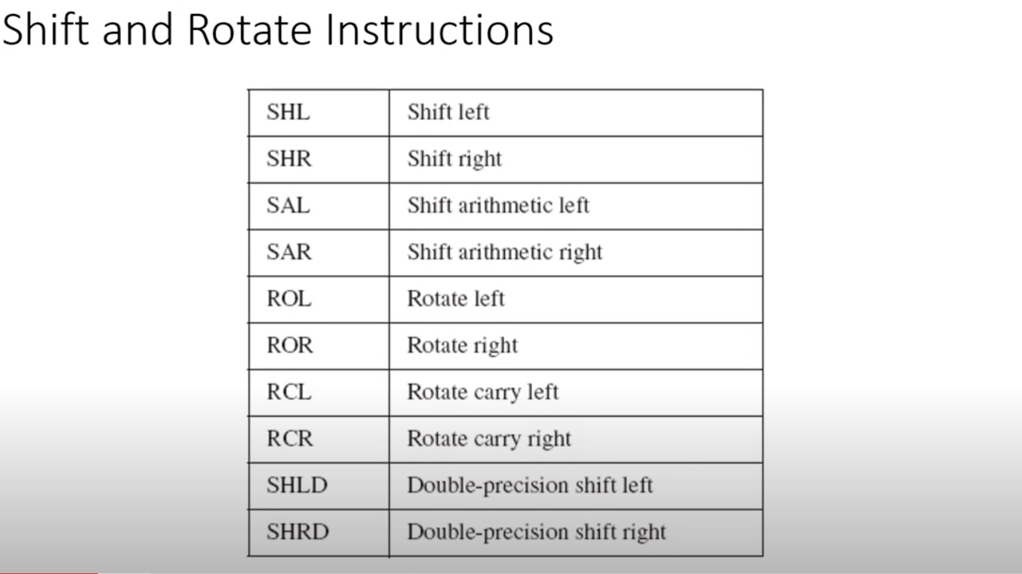

Slide 5
3.) Shift Arithmetic Left (SAL)

Slide 6
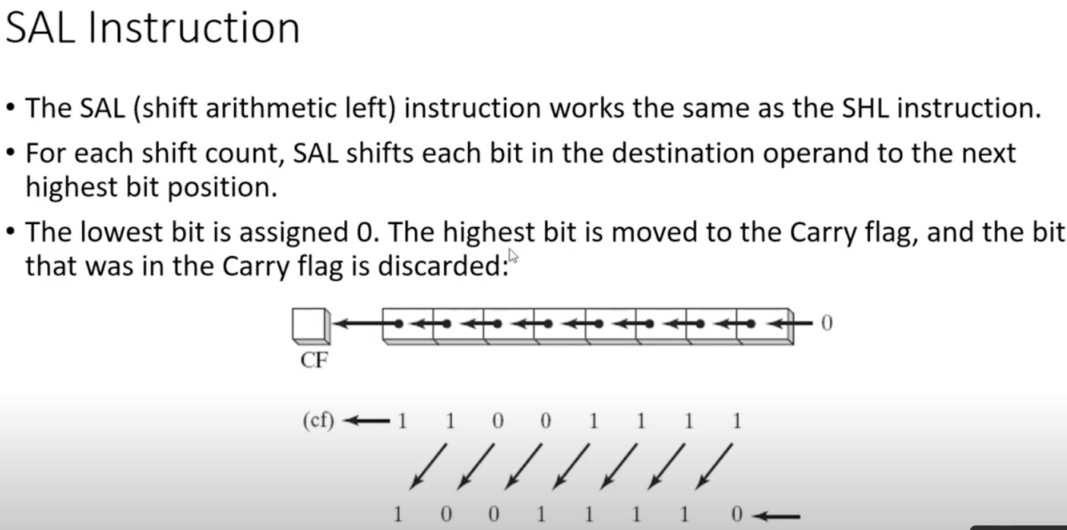
3.) Shift Arithmetic Left (SAL)

Slide 7
4.) Shift Arithmetic Right (SAR)

Slide 8
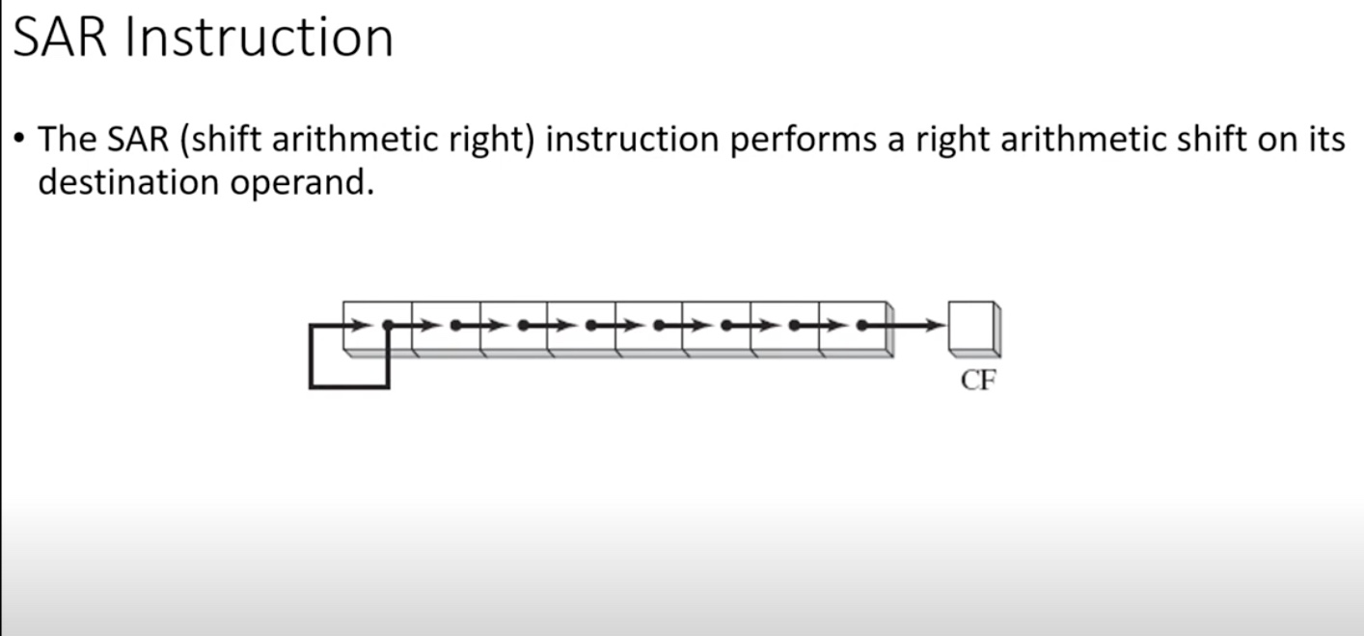
4.) Shift Arithmetic Right (SAR)

Slide 9
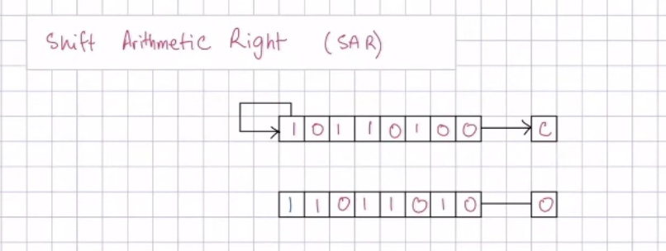
4.) Shift Arithmetic Right (SAR)

Slide 10
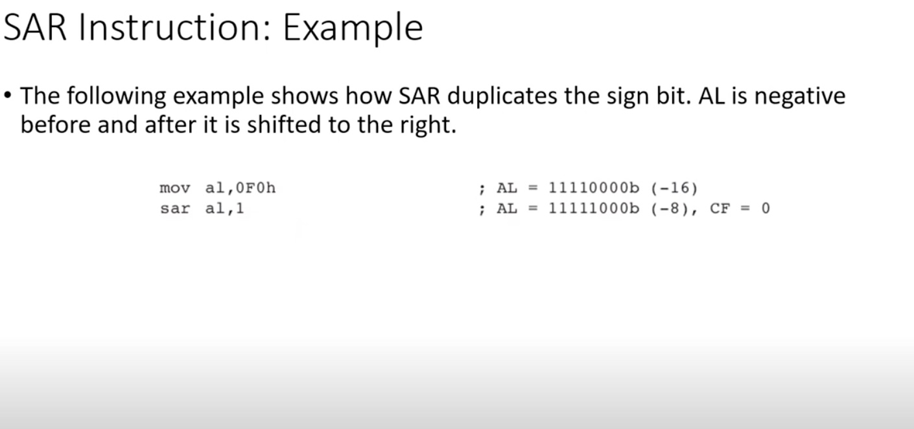
4.) Shift Arithmetic Right (SAR)

Slide 11
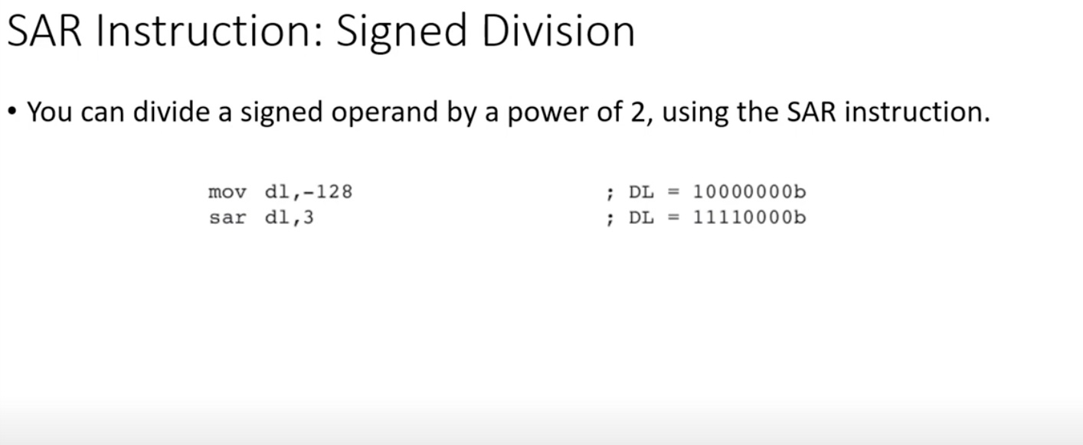
4.) Shift Arithmetic Right (SAR)

Slide 12
5.) Rotate Left (ROL)

Slide 13
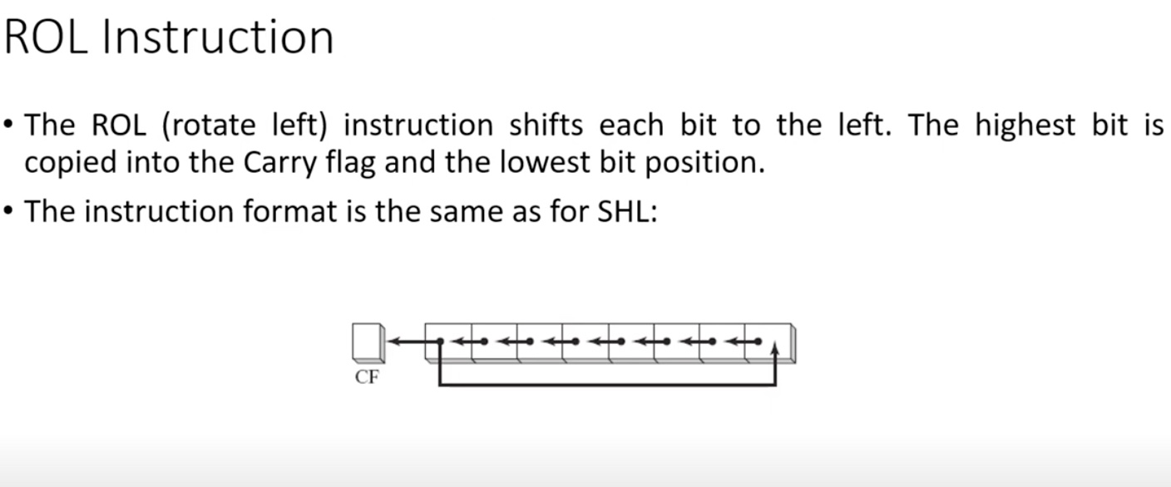
5.) Rotate Left (ROL)

Slide 14
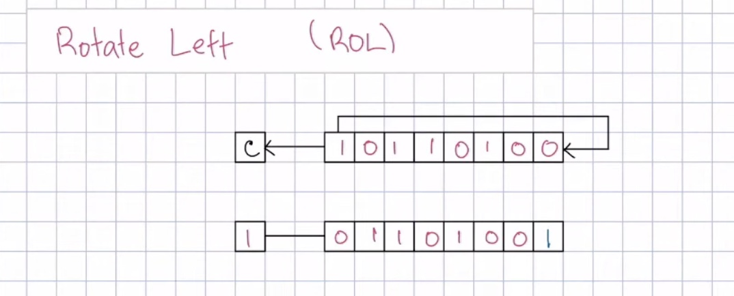
5.) Rotate Left (ROL)
Notes:
example after this

Slide 15
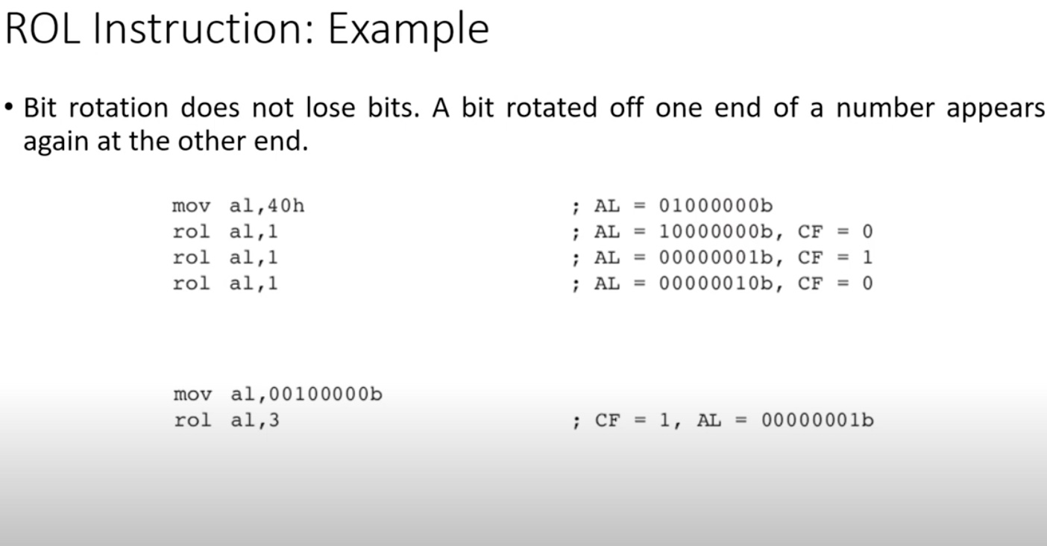
5.) Rotate Left (ROL)

Slide 16
6.) Rotate Right (ROR)

Slide 17
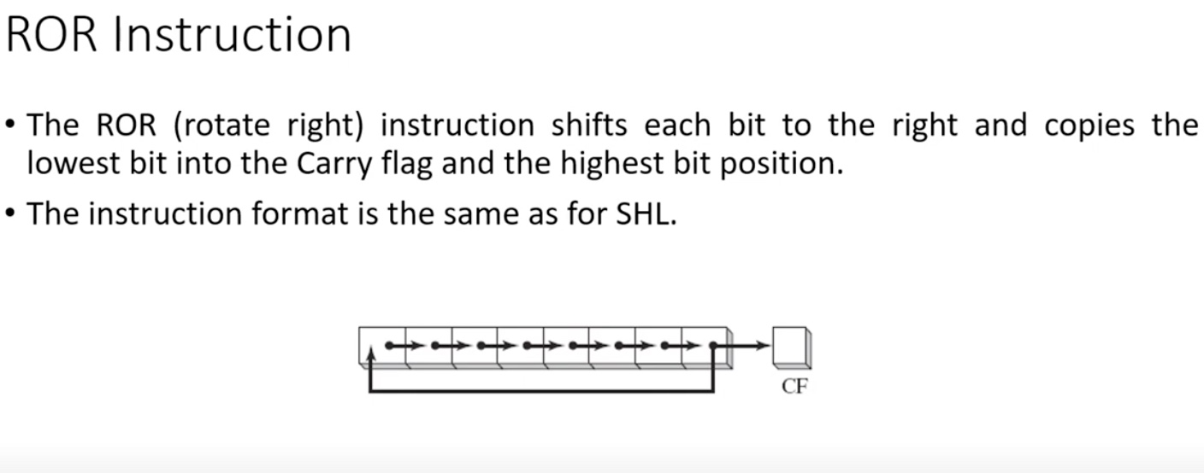
6.) Rotate Right (ROR)

Slide 18
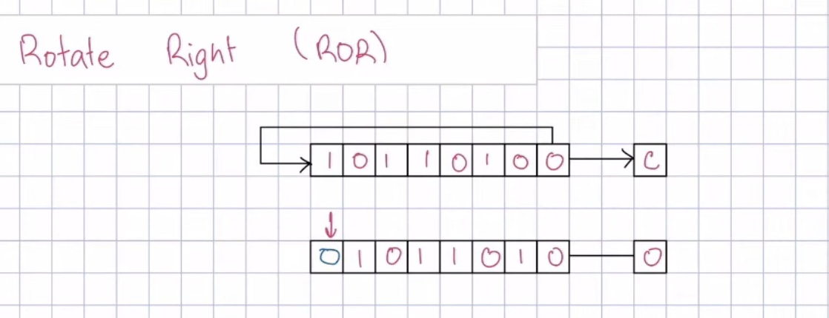
6.) Rotate Right (ROR)

Slide 19
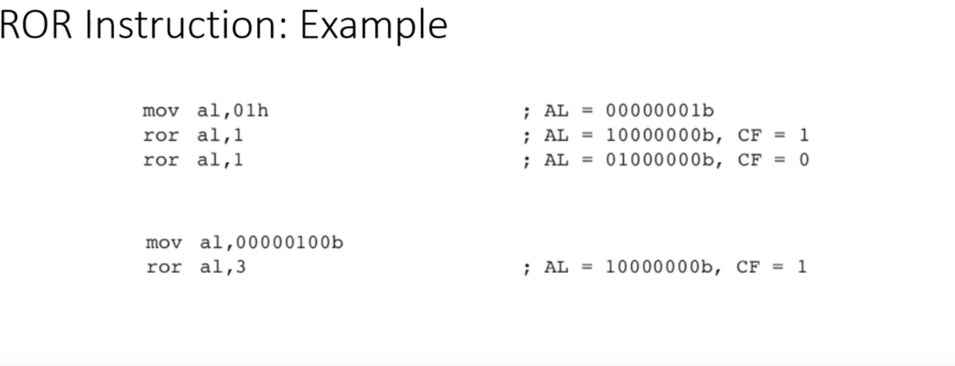
6.) Rotate Right (ROR)

Slide 20
7.) Rotate Carry Left (RCL)

Slide 21
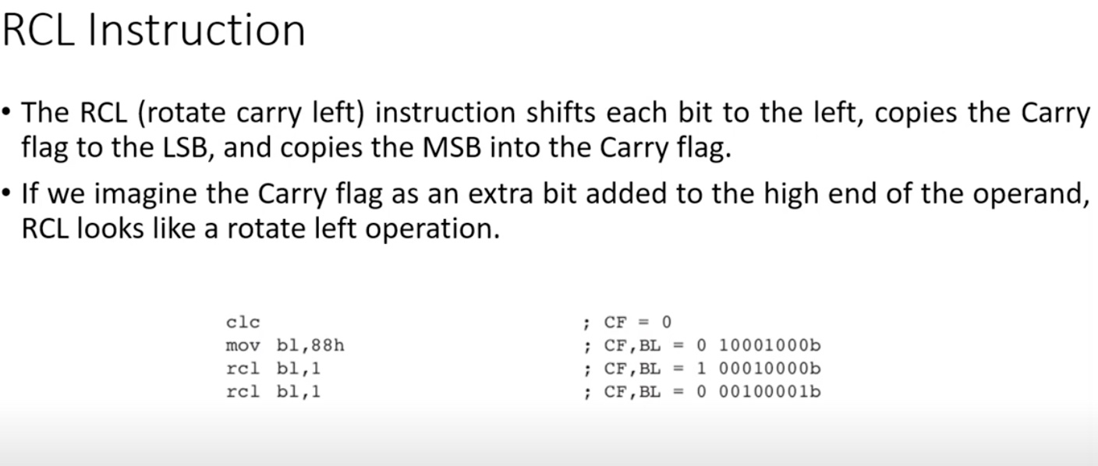
7.) Rotate Carry Left (RCL)

Slide 22
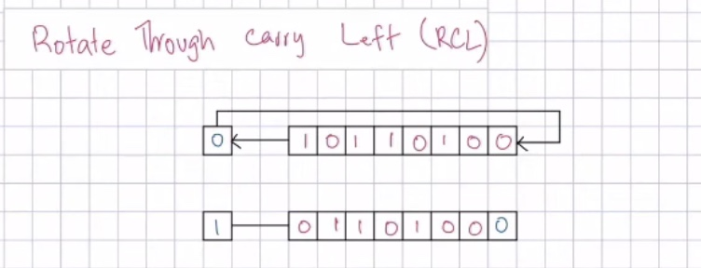
7.) Rotate Carry Left (RCL)

Slide 23
8.) Rotate Carry Right (RCR)

Slide 24
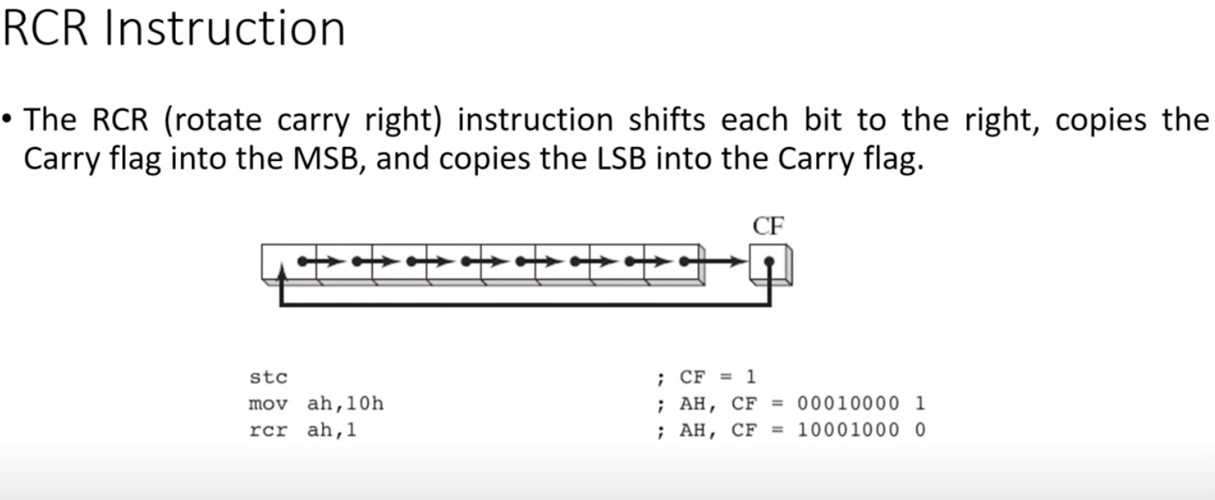
8.) Rotate Carry Right (RCR)

Slide 25
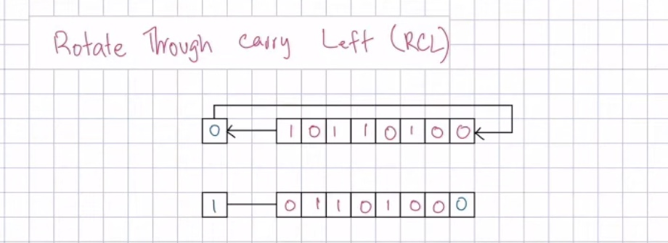
8.) Rotate Carry Right (RCR)

Slide 26
9.) Shift Left Double (SHLD)

Slide 27
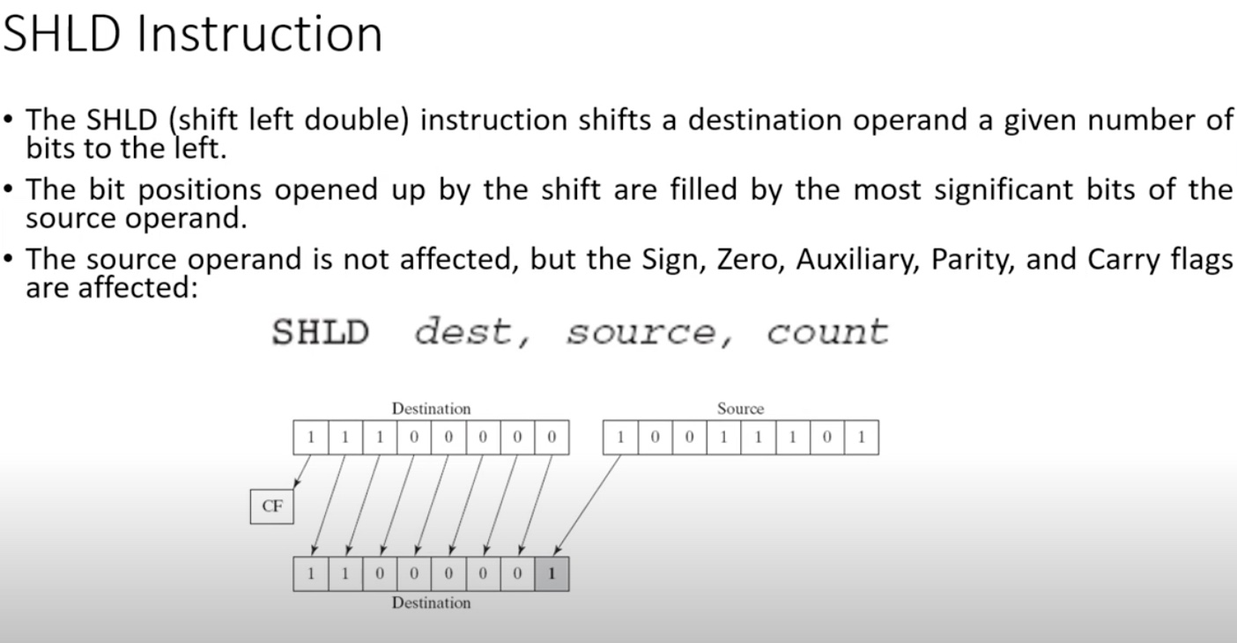
9.) Shift Left Double (SHLD)

Slide 28
10.) Shift Right Double (SHRD)

Slide 29
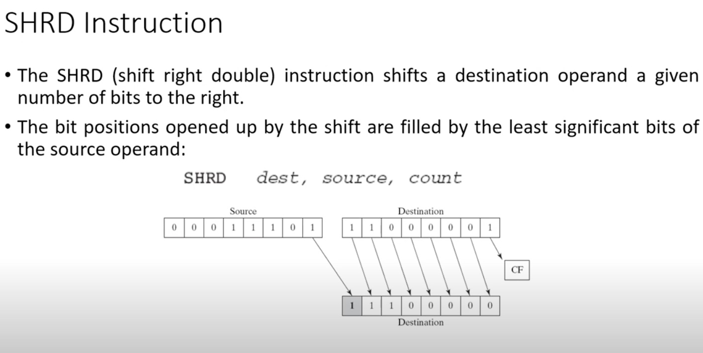
10.) Shift Right Double (SHRD)

Slide 30
Announcement :
“Quiz 3 in next class”
Date: (30-4-2025) / Wednesday
Syallabus : Chap 4 (Shifting and Rotatiion)

Slide 31
End of Lecture

